Slide 1
Introduction to LaTeX
Chris Cooling
Graduate School Senior Teaching Fellow
Alexis Belessiotis-Richards and Scott Melville

Slide 2
Important Information on Marking your Attendance on Inkpath I will show you a QR code at the end of the session allowing you to mark your attendance on Inkpath. Please do not mark your attendance until then. If you are a Postgraduate Research student, this is required for receiving your Graduate School credit for this course.
Notes:
No additional notes.

Slide 3
Learning Outcomes
Recognise the advantages of LaTeX and its applications in the wider context of typesetting
Identify the key features for reading and compiling an existing .tex document
Develop new technical documents from simple templates
Create simple equations, figures, tables, lists and references within LaTeX
Assess and troubleshoot common compiler problems and use online aid tools

Slide 4
Using this PowerPoint
Further notes and comments in the notes section of most slides
Annotates and explains the examples
Notes also often contain links to Overleaf projects used to generate examples
Allows you to see the example in the context of a compete project

Slide 5
LaTeX
What is LaTeX?
How do I use it?
Why would I use it?
Notes:
LaTeX is a powerful and versatile typesetting tool. It’s exceptionally well-suited to the production of high quality technical reports including journal articles and theses. It provides advanced tools to include and customise equations, figures, references, bibliographies including the automation of many tasks. In addition, a large number of optional extensions exist to provide specialist functionality. And if something suiting you doesn’t exist, you can create it yourself. To use LaTeX, you create a tex file and then compile it into a pdf. This may be done by invoking terminal commands or through the use of a LaTeX editor, such as MikTex which can be installed locally on your machine or through an online editor such as Overleaf. You may then edit the tex file and recompile the pdf and repeat until you’re happy with your final document. Most of this introduction to LaTeX will focus on what may be written into your .tex file to create different effects in the final pdf.

Slide 6
Overleaf
Online environment for creating and compiling LaTeX documents
Pros
Cross-platform
Complete
Easy to use
Allows collaboration
Integrated “review” system for feedback
Cloud syncing with Dropbox and Github
Cons
Editor online only
Data stored online – consider you data
Notes:
Overleaf is the online environment which we’ll be using to create and compile your LaTeX documents. College has a subscription to it so, if you sign up with your college email address, you can get the pro-version. You should have already made an account as indicated in the pre-course instructions. Overleaf is cross-platform (in the sense it will work on Windows, Mac, Linux, etc). It’s already complete in the sense that all the packages you might need are already installed. It’s easy to use, including auto-complete and a visual indication of where errors have occurred in compilation. It has the ability for collaborative working and allows synchronisation with Dropbox and github which can allow you carry on working on your documents offline using an offline editor. Overleaf also has an integrated “review system” which might allow your supervisor or collaborator to review your document in the same place that you’re writing it, saving a lot of flipping between documents. However, the editor itself is only available with an internet connection. Your files are also stored online. If you’re dealing with commercially sensitive data or sensitive data such as patient records, you may not be able to use Overleaf if there are restrictions on where you can store data.

Slide 7
Creating a document
\documentclass[12pt,a4paper]{article}
\usepackage{graphicx}
\usepackage{amssymb, amsmath}
\usepackage[citecolor=black]{hyperref}
Preamble
Main body
\begin{document}
% What you don’t see
What you see %You also don't see this
\end{document}
Comments
Problem Sheet
Notes:
A .tex document is split into two sections – the preamble and the main body. The preamble includes specification of settings for LaTeX to use in your document but does not include any content which will appear in the document. The preamble will always include a declaration of the documentclass. This tells LaTeX what type of document you are creating, which enables certain features and helps define how your final pdf will look. Common documentclasses include “report”, “article”, “book” and “slides”. Within the preamble, you will normally specify a number of “\usepackage” commands which specify which optional LaTeX features you want use. It’s relatively common to have a few dozen packages used in a complex document, but you don’t need to use many (or, indeed, any). Within the preamble both the “documentclass” and “usepackage” commands may contain options within square brackets which allow other details to be set by the user. You can quickly change how your document looks by changing the content of your pre-amble.
In the example above, we set the default font-size of the document to be 12pt and choose to use A4 paper (this is the default, so we could have omitted this option). Different documentclasses support different default font-sizes. For an article, the sizes 10pt, 11pt, and 12pt are supported. The description of the text that actually appears in your document falls between the “begin document” and “end document” statements. If you include a “percent” symbol any characters following it will be treated as a “comment”, meaning it will not be used when your pdf file is created. This can be useful for keeping notes about the contents of your file to make it easier to understand.
Break for section 1 of Task Sheet

Slide 8
Paragraphs
Line A
Line B
Line C
Notes:
In LaTeX, a line break in the .tex file will not produce a line break in the pdf. Instead, we must create a new paragraph. There are a couple of ways to do this, but the simplest and easiest way is to leave a blank line in the .tex file.
It’s also worth noting that, at the start of a new block to text (such as at the start of a new section) the first paragraph will not be indented. However, subsequent paragraphs will be to make it easier to see where they start. This look a bit odd with single-line paragraphs (such as the ones you might be writing in the exercises), but with longer paragraphs it looks a lot more natural and makes a lot more sense.
It is possible to modify the way new paragraphs look, including indentation and white space between paragraphs, but this is beyond the scope of this course.
Overleaf example: https://www.overleaf.com/read/ctsdkmwxrfhy

Slide 9
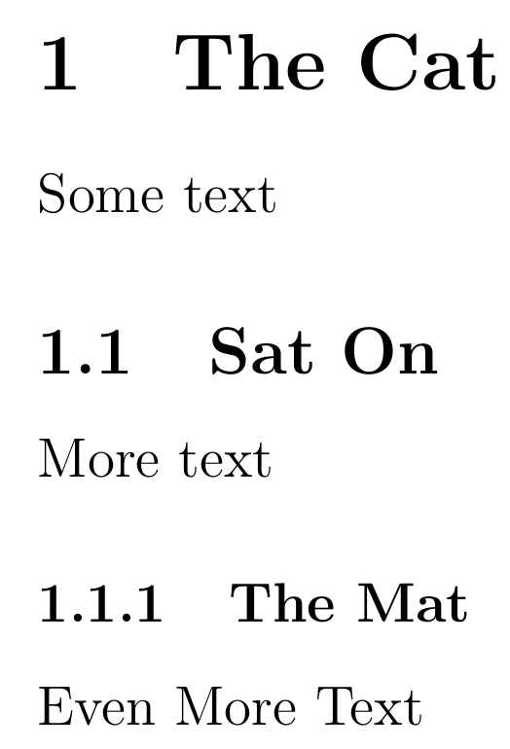
Sections
\section{The Cat}
Some text
\subsection{Sat On}
More text
\subsubsection{The Mat}
Even More Text
Notes:
You can use sections and subsections to break up and categorise your document. Using the commands “section”, “subsection” and so on allows you to specify the name of a section and then specify the content to be contained within the (sub)section.

Slide 10
Chapters
\chapter{A Poem}
\section{The Cat}
\subsection{Sat On}
\subsubsection{The Mat}
Notes:
You can further use chapters to break up your document into larger sections. The chapter command is an example of a command which is not available in every type of documentclass – it is available in the “report” and “book” documentclasses but not in the “article” or “slides” document class.
Different document classes may also handle chapters, sections and paragraphs differently by default, such as which (if any) begins a new page. For example, the book document class will put a chapter on the first page of a new double-page spread, which can mean a blank page is left before the start of a new chapter.
Overleaf example: https://www.overleaf.com/read/cpkybhpfdgsb

Slide 11
Table of Contents
Contents
1 The Cat 1
1.1 Sat On……... 2
1.1.1 The Mat… 3
\tableofcontents
Notes:
A Table of Contents may be easily inserted using the command “tableofcontents” command, which automatically detects the page numbers of chapters, sections and so on.
Overleaf example: https://www.overleaf.com/read/gjdnkmkdnnqd

Slide 12
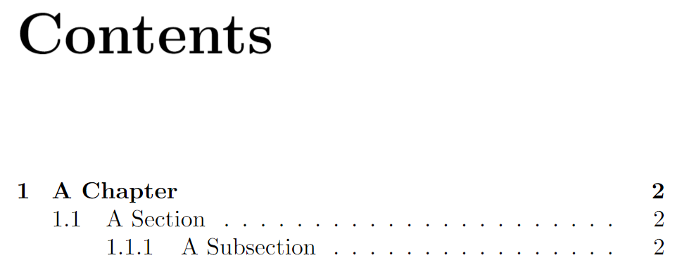
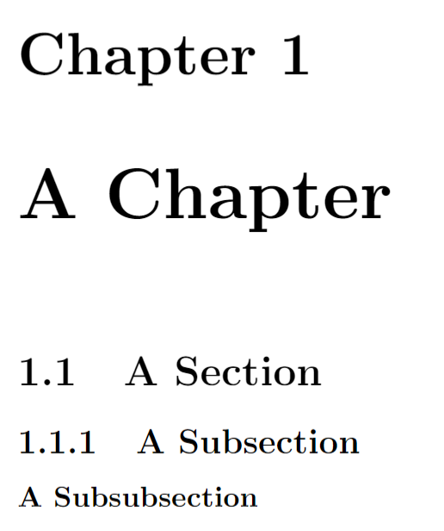
Section and Chapter Depth
\tableofcontents
\chapter{A Chapter}
\section{A Section}
\subsection{A Subsection}
\subsubsection{A Subsubsection}
Notes:
By default, LaTeX will only number sections 3 levels deep (e.g. chapter, section, subsection in the report documentclass). So, using the subsubsection command will result in an unnumbered division of the document.
Tables of contents will also omit sections more than 3 levels deep by default. This mean subsubsections also won’t appear in the Table of Contents by default.

Slide 13
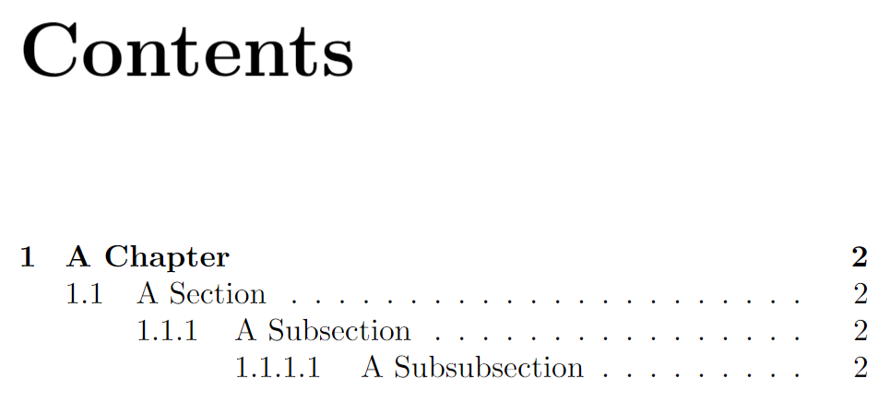
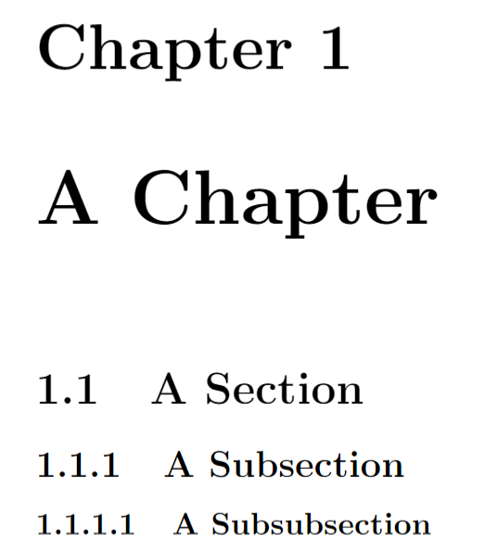
Section and Chapter Depth
Add to preamble
\setcounter {secnumdepth}{3}
\setcounter{tocdepth} {3}
Depth 0
Depth 1
Depth 2
Depth 3
Problem Sheet
Notes:
We can modify the dept that LaTeX will number sections to by modifying a value called “secnumdepth”. We ca do this by using the /setcounter command in the preamble. The default value for secnumdepth is 2 and determines the depth of the lowest-level division which will be numbered. The highest level subdivision of the document is level 0 so, by default, the highest three levels are numbered. Setting this value to 3 means the highest 4 levels are numbered. For our report class, this means subsubsections will now also be numbered.
We can also modify the “tocdepth” value which controls the maximum depth of the contents.
Overleaf example: https://www.overleaf.com/read/zbyhyfrjpmzx
Break for section 2 of Task Sheet

Slide 14
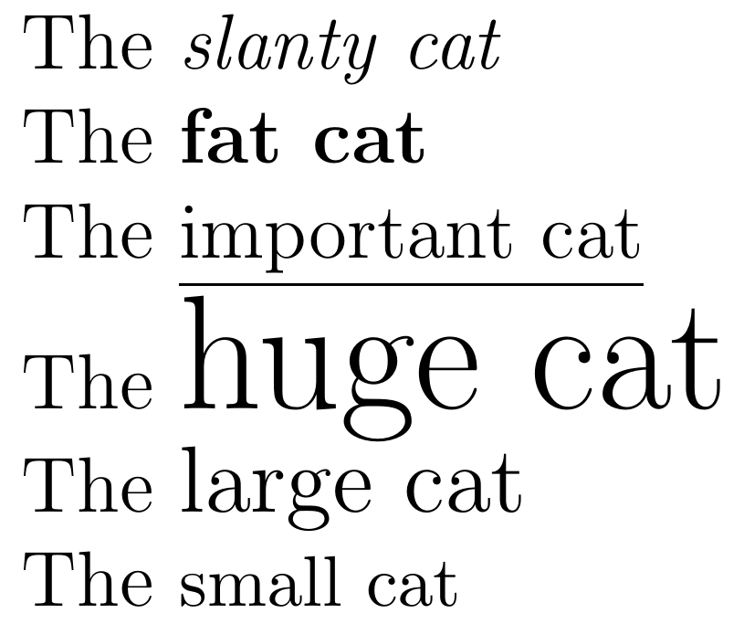
Modifying Text
The \emph{slanty cat}
The \textbf{fat cat}
The \underline{important cat}
The {\huge huge cat}
The {\large large cat}
The {\small small cat}
Problem Sheet
Notes:
Different command may be used in the middle of normally written text which modifies how the text appears in the final pdf.
The “emph” command italicises text
The “textbf” command makes a text bold
The “underline” command underlines text
The “huge” command makes text very large
The “large” command makes text large
The “small” command makes text smaller
Overleaf example: https://www.overleaf.com/read/bmvnftnttnzk
Break for section 3 of Task Sheet

Slide 15
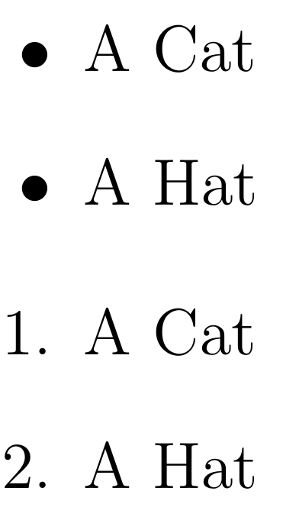
Lists
\begin{itemize}
\item A Cat
\item A Hat
\end{itemize}
\begin{enumerate}
\item A Cat
\item A Hat
\end{enumerate}
Problem Sheet
Notes:
Bulletpoint and numbered lists can be created easily in LaTeX using the “itemize” and “enumerate” commands respectively. In each case the environment is begun and ended using the “begin” and “end” commands. New items belonging to the list are then signified using the “item” command which is followed by the text associated with that item.
Overleaf example: https://www.overleaf.com/read/rvrgkkhvzpwn
Break for section 4 of Task Sheet

Slide 16
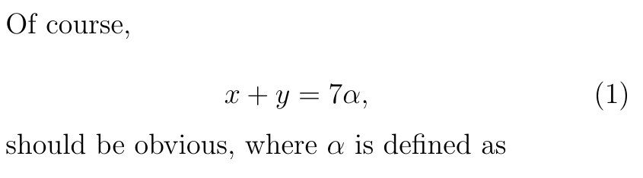
Equations
Of course,
\begin{equation}
x + y = 7 \alpha,
\end{equation}
should be obvious, where $\alpha$ is defined as
Notes:
An equation may be included utilising the equation environment which is, again, started and ended by the “begin” and “end” commands. Text in this environment is interpreted in “mathmode” which changes how the text appears, such as italicising it, and allowing the use of mathematical symbols such as the “alpha” symbol we have included with the “alpha” command. Note that LaTeX automatically numbers equations. If you want to include “mathmode” commands inline with normal text, the “dollar” symbol can be used to start and end “mathmode”.
Overleaf example: https://www.overleaf.com/8251716838wnbtxwjybszb

Slide 17
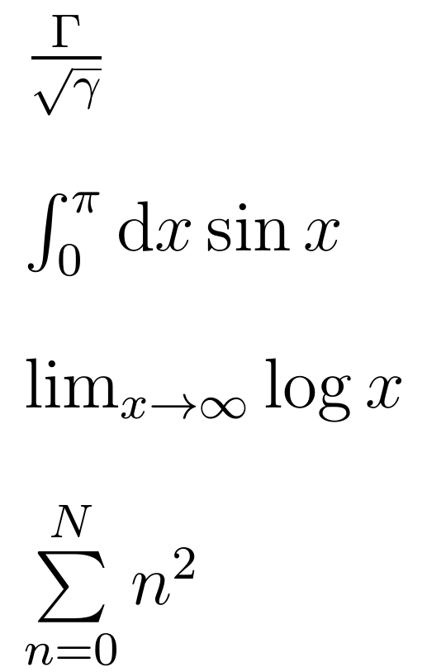
Mathmode Commands
$\frac{ \Gamma }{ \sqrt{\gamma} }$
$\int_{0}^{\pi} \textrm{d}x \sin x$
$\lim_{x \to \infty} \log x$
$\sum\limits_{n=0}^{N} n^{2}$
Problem Sheet
Notes:
Here we’ll look at a few examples of mathmode commands. For many of these, a package (often “amsmath” and “amssymb” will be required to make sure the right commands are available.
In the first command, the “frac” commands has two sets of curly brackets. The numerator is specified within the first pair of brackets and the denominator is specified in the second. We also see the square root command and the appearance of upper and lower case Greek characters.
In the second, we see the integral command. In mathmode, the underscore character, followed by a pair of curly brackets, typically defines text to appear in subscript and the “hat” character typically defines text to appear in super-script.
In the third, we see the commands for limit and log, as well as an arrow to signify “tending toward” and infinity.
In the fourth we see the summation command. Here, we have also used the “limits” command to cause the limits of the summation to appear above and below the summation symbol rather than to the right of it, as with the integration symbol. The use of the “limits” command is not compulsory, but it does look neater. There are a large number of mathmode commands and this is a quick sample of them. Google is your friend in finding specific commands.
Overleaf example: https://www.overleaf.com/read/rwkzhszhmfcd
Break for section 5 of Task Sheet

Slide 18
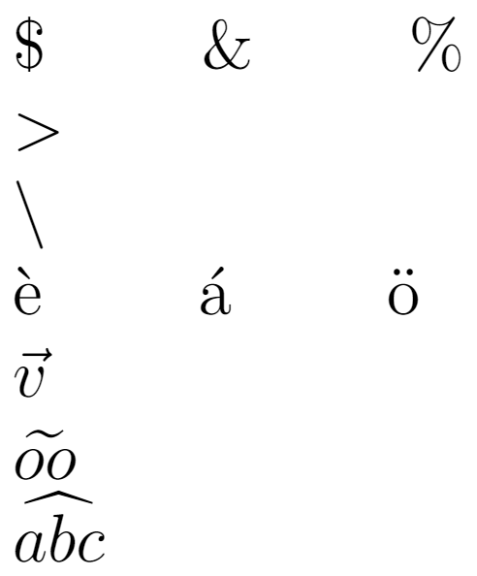
Special Characters
\$ \& \% \textgreater
\textbackslash \`{e} \’{a} \"{o}
$\vec{v}$
$\widetilde{oo}$
$\widehat{abc}$
Notes:
Some characters require special commands in LaTeX. This may be because they are characters LaTex uses for other purposes, they’re too uncommon to appear on a keyboard, they’re an accented letter or they’re a weird and wonderful mathematical construct that encompasses multiple characters. Again, the list here is completely non-exhaustive and almost anything you can think of is possible. If you don’t know how to achieve a character you can normally find it using Google pretty quickly.
Overleaf example: https://www.overleaf.com/read/jsksjfbyghkk

Slide 19
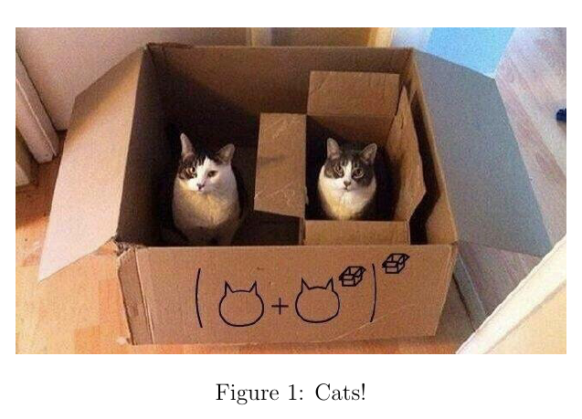
Figures
Add to preamble
Specifier | Position
h | “Here”
t | Top of page
b | Bottom of page
\usepackage{graphicx}
\begin{figure}[t]
\centering
\includegraphics[width=10cm]{Cat_Box}
\caption{Cats!}
\end{figure}
Problem Sheet
Notes:
There are a number of ways to include a figure in LaTeX and a wide range of options that you might use. This is one example of something you might consider. The “\begin{figure}” command tells LaTeX you’re about to define a figure. The “t” in square brackets is an optional argument which tells LaTeX where you would like to put the figure. In this case, you’re asking for the figure to be put on the top of the next page if possible. Conflicts can occur, such as when multiple figures are requested to be included at the same location. LaTeX will do its best to position figures conforming to the locations you’ve specified and also to try and reduce the amount of white space in the document. Other options to be used are “h” which asks the figure to be placed as close as possible to the text above the figure, including the middle of the page. “b” requests the image is placed at the bottom of the page.
The “centering” command lets LaTeX know that you would like the picture to be located centrally horizontally. The “includegradphics” command lets LaTeX know you would like to include a picture file with the name in the curly brackets, “Cat_Box” in this case. Note the file extension is excluded – LaTeX will search for standard image files, e.g. Cat_Box.jpg, Cat_Box.png, etc. By default, this file should be in the same directory as your .tex file. The “width” statement sets the width of the picture.
The caption command allows you to include a caption for the picture which, by default, appears under the picture.
Finally, the “\end{figure}” command ends the specification of the figure.
Overleaf example: https://www.overleaf.com/read/ymfkjjdthvwq
Break for section 6 of Task Sheet

Slide 20
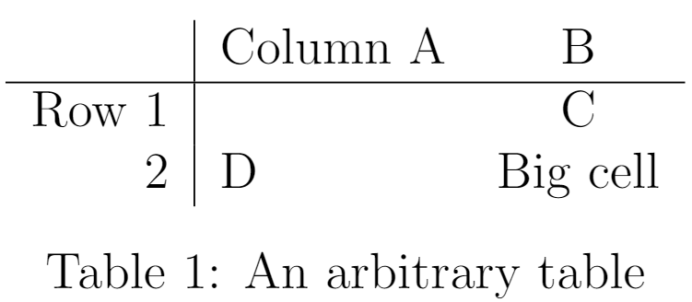
Tables
\begin{table}[h]
\centering
\begin{tabular}{ r | l c }
& Column A & B\\
\hline
Row 1 & & C \\
2 & D & Big cell
\end{tabular}
\caption{An arbitrary table}
\end{table}
Problem Sheet
Notes:
Tables can be included in LaTeX documents in a similar way to figures. The first command “\begin{table}” tells LaTeX to expect a table. In this case, we’ve chosen to include a “h” in square brackets to tell LaTeX to put the table as close as possible to the location it’s been specified in the text. Again, the “centering” causes the table to be centered horizontally on the page. Within the “tabular” environment we specify the contents of the table. In the curly brackets immediately after we begin this environment we specify the columns, their alignment and any lines between the columns. The number of these characters determines the number of columns, and which characters we use specifies the alignment. Here we have specified that we want text in the left column to be right-aligned within the column, text in the middle column to be left-aligned and text in the rightmost column to be centre-aligned within that column. The vertical line between the specification of the first and second column specifies that a vertical line is to be included in the table. If we don’t want a vertical line, as between columns 2 and 3, we don’t include a line. Next, we begin to specify the contents of the table itself. We do this row by row, with rows separated by a double backslash. It’s not required to put each line of the table on a new line of your .tex file, but it’s a good idea as it makes your file easier to read. Ampersands separate the specification of material within each column of the current row. In this case, for row 1, we include an ampersand before any text, causing the first column of row 1 to be empty. In rows 2 and 3 we specify something before the ampersand, so column 1 has entries in these rows. Between the specification of lines 1 and 2 we use the “hline” command to specify the inclusion of a horizontal line between these rows. Finally, we end the tabular and table environment with the corresponding “end” commands.
Overleaf example: https://www.overleaf.com/read/dbmrcfcdhgsg
Break for section 7 of Task Sheet

Slide 21
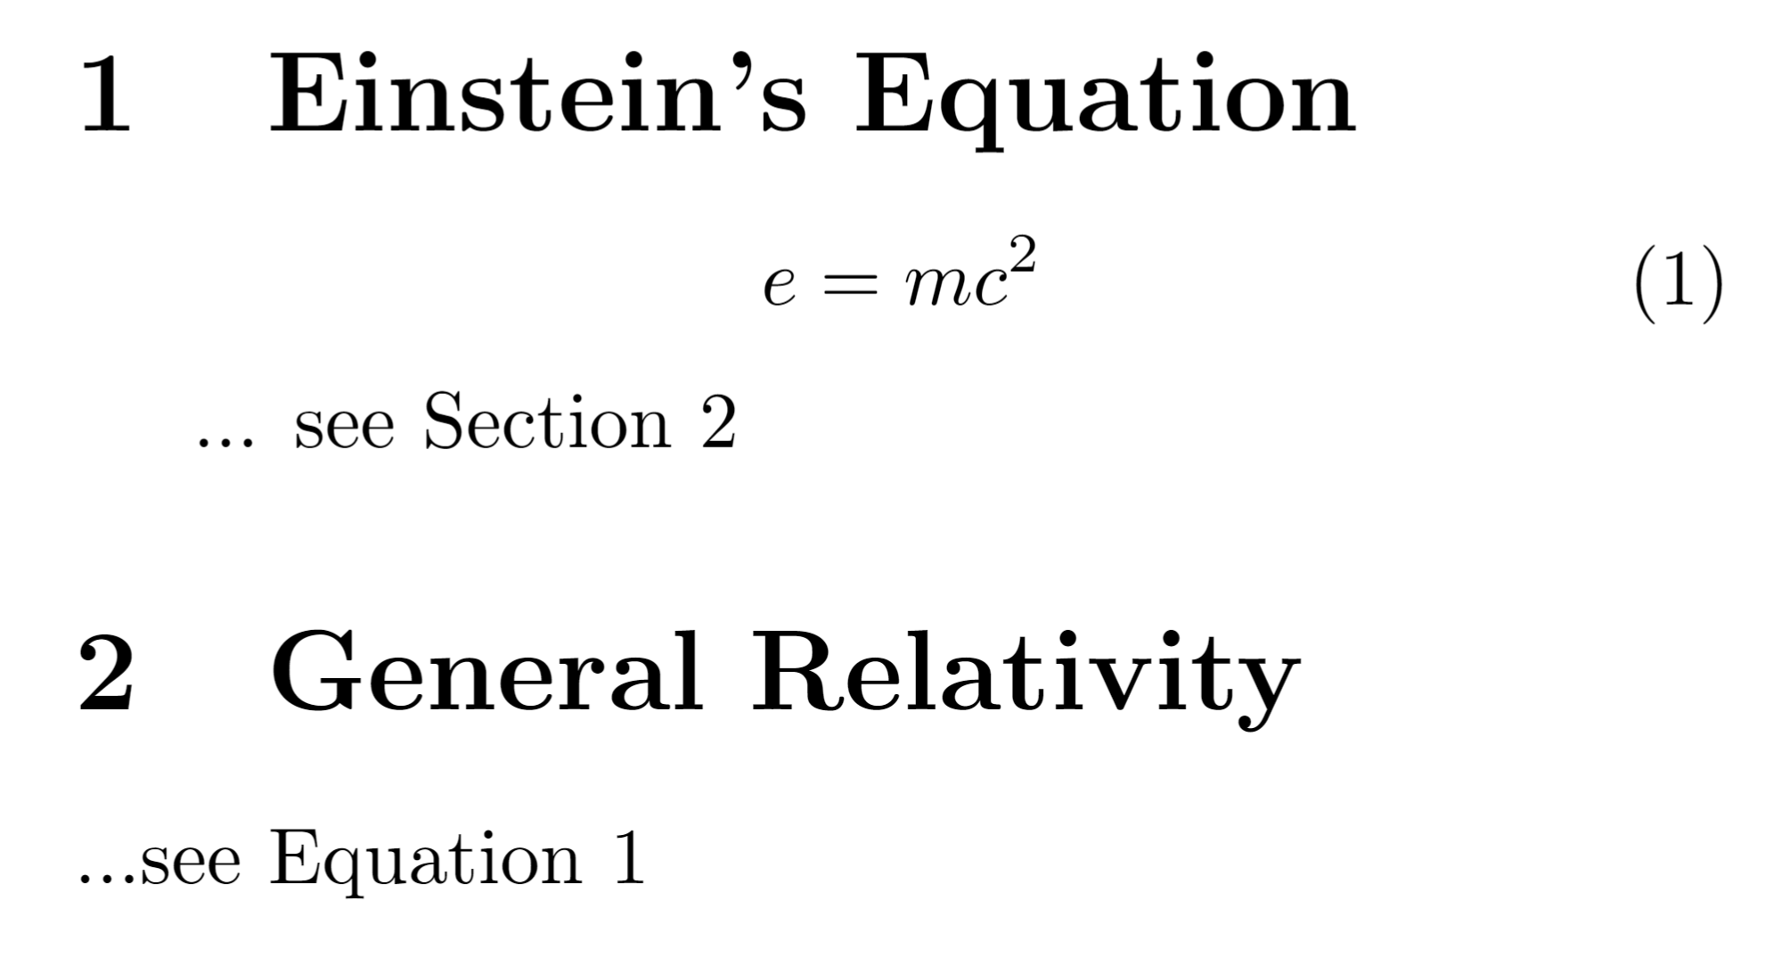
Referencing
\section{Einstein's Equation}
\begin{equation}
e = mc^{2}
\label{eq:energy_mass}
\end{equation} ... see Section \ref{sec:general_relativity}
\section{General Relativity} \label{sec:general_relativity}
...see \ref{eq:energy_mass}
Problem Sheet
Notes:
LaTeX makes the management of referencing different sections and constructs within the document very easy. The first step is to label the thing you want to reference using the “label” command and specifying the keyword you want to use to reference that entity. If this command is within an equation, figure, table and so on, that is what is being given that label. If it’s not in any of these constructs, the label will be applied to the current section or chapter.
The name you label something with can be anything and will not appear anywhere in your final document, but it must be a unique label. It is wise to make the label something relevant to the construct it is labelling. You may also want to give a prefix such as “eq:” for equations, or “sec:” for sections. This makes it less likely you will accidentally create duplicate labels, and makes it easier to see what labels apply to.
The next step is to reference the entity you labelled. This is typically done using the “ref” command, which is followed by the label of the entity you wish to reference in curly brackets. In the text, this is replaced by the number of the entity referenced. For instance, if you reference the second section, the label command will be replaced by the number “2”.
Note that you can reference labelled entities that occur before or after the reference in the .tex file. If you update your tex file to include more equations, causing the number of the referenced equation to change, the number which appears in the reference will also change in your pdf when you recompile it. This means you can undertake wide-ranging restructuring of your document and references will still automatically point to the right place.
Overleaf example: https://www.overleaf.com/read/xcdwqnttrqzp

Slide 22
Bibliography Management
Many documents will have a large number of references
There are many ways to include references and citations in LaTeX
Many reference management programs allow the exporting of bibliogrpahies in a .bib file
Notes:
Publications often have dozens of citations and your thesis is likely to have dozens or hundreds of references and so a good way to manage with your references is desirable. There are many ways to manage your references and many ways to personalise your citations. We’re going to run through one way to achieve a streamlined approach to referencing. Many reference managers such as EndNote, Mendeley and JabRef allow for your database of references to be exported as a “.bib” file. This is essentially a database of your references that LaTeX can interact with directly. This means you only need to enter your reference details once in your reference manager and it will feed through to your LaTeX documents including your thesis. If you combine this with the automatic population of fields in your reference manager you will never need to manually write the author of a reference again. This saves a lot of time and effort you can better spend elsewhere.

Slide 23
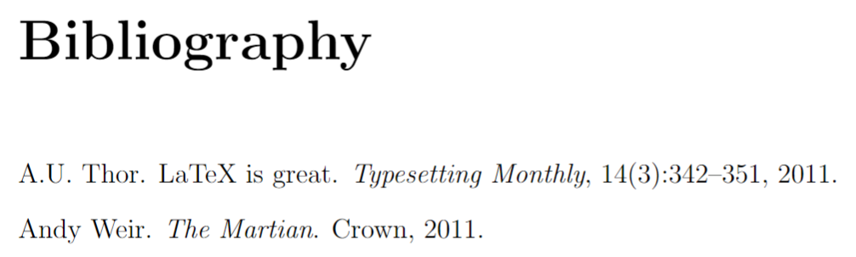
Bibliography Management
myrefs.bib
@article{Thor_2011,
author = "A.U. Thor",
title = "{LaTeX} is Great",
year = "2011",
journal = "Typesetting Monthly",
volume = "14",
number = "3",
pages = "342--351" }
@book{Weir_2011,
author = “Andy Weir",
title = “The Martian",
year = “2011",
publisher = “Crown"}
Notes:
A “.bib” file consists of one entry for each reference. An new entry is begun with a “@” symbol and the name of the type of entry it is. Here, we have one article and one book. There are many other types such as “report”, “conference” and even “phdthesis”. See here for some more examples: https://www.verbosus.com/bibtex-style-examples.html
Within curly brackets, the first entry is a label for your reference. Following that, we then have a series of fields which define the contents of the reference. These come in the format “field name = field value” and are separated by commas. Different entries are valid for different entry types. For instance, both our entries here have “author”, “title” and “year” fields but the article has the fields “journal”, “volume”, “number” and “pages” fields whilst the book has a “publisher” field. When you compile your main .tex file, your bibliography will appear and any entries that are cited will appear in your bibliography. Entries you have not cited will not be included by default.
Overleaf example: https://www.overleaf.com/read/tfrbytxxqszf

Slide 24
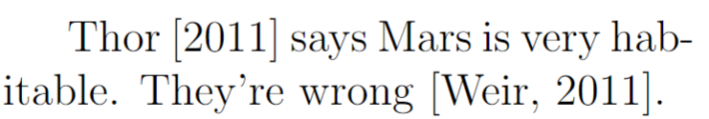
Bibliography Management
main.tex
\usepackage{natbib}
\begin{document}
\citet {Thor_2011} is much better than its competitor \citep {Rowling_1997}
\bibliographystyle{plainnat}
\bibliography{myrefs}
Problem Sheet
Notes:
In your main .tex file, you need to use the package “natbib” in your preamble. You can then cite a reference using the “citet” command with the label of the reference. This produces a reference which is “textual” in the sense that the author name is written in normal text as if it’s being read as part of the sentence. You can also use “citep” to include the entire reference within brackets. This can be useful for when you don’t intend for the reference to be read as part of the sentence, but to act as an addendum. After the main body of your text, select a bibliography style (we’ll use “plainnat” for now). Then, use the “\bibliography” command to actually insert your bibliography into your text. This is followed by the name of your “.bib” file in curly brackets (do not include the “.bib” extension here).
Overleaf example: https://www.overleaf.com/read/tfrbytxxqszf

Slide 25
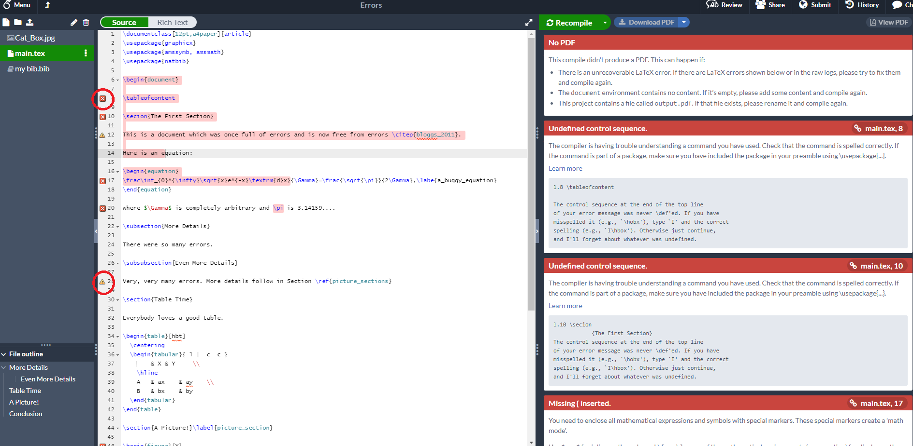
LaTeX Errors
Problem Sheet
Notes:
As LaTeX runs, it keeps a log of what it’s doing. Most of these messages can be safely ignored. However, one class of message that is very helpful is the error message. Overleaf, like all LaTeX compilers will keep a log of all messages is generated. When LaTeX hits a section of code with an error, it will typically generate a number of useful messages and then stop progressing further. If you carefully read the messages, they often lead you straight to the source of the error.
LaTeX will normally tell you what the error is and on what line of the file the error occurred. Overleaf takes this a step further and shows you a small error symbol next to the line number. You can hover over this to read the error message. The full message log can be read by clicking the “Log and Output Files” button next to the “Recompile” button just above where the pdf is normally displayed. When you receive an error from LaTeX (in Overleaf, or from whatever LaTeX compiler you’re using), read the error message, edit your tex file to correct the error and recompile the pdf. Hopefully you will have fixed the error. Otherwise, you’ll receive another error message. LaTeX will also give you warnings, telling you if there was something it wasn’t sure what to do with, but was able to complete the document in any case. It’s also a good idea to look through the entire pdf by eye for anywhere that you’ve given a valid instruction, but one that has produced a different result to what you wanted.
When tackling errors, it’s often worth correcting the earliest error first – sometimes doing so will fix subsequent errors.
Latex example: https://www.overleaf.com/read/gnzphcnqgfvf
Break for section 10 of Task Sheet.

Slide 26
Journal Submission
Journal documentclasses
Submit your source files
Perfection not required
Notes:
If you’re working on a document to submit to a journal, there are a number of things to bear in mind. Many journals have custom documentclasses which they make available and you can chose to use when submitting. Some journals might require you to use their documentclass when submitting. In many cases you can submit your LaTeX source files to the journal as well. This aids the typesetters at the journal in working on your document. For many journals, typsetters will alter your script substantially to make sure it fits the standards and style of the journal. This means that you don’t need to make your document look perfect when you submit it. You need it to be easily legible for the reviewers and editors to read, but spending days tweaking fine details might not be a good use of your time. Check the process and requirements of the journal you’re submitting to so you fulfil all their requirements but don’t put in effort that will ultimately be wasted.

Slide 27

Online Tools
Google
Stack Exchange
Overleaf
Wikibook
Table Maker
Equation Editor
Mathpix
Detexify
Notes:
If you want to do something in LaTeX but don’t know how, the first thing to do is to Google it. Somebody has almost certainly had your problem/desire before and you can copy their solution most of the time. On many occasions, you’ll find the answer of stackexchange. As well as being a useful environment to develop and run LaTeX, Overleaf has an extensive library of documentation on LaTeX’s functions. There’s also a very good wikibook that contains a good description of the functionality of LaTeX. There’s also a good table maker which allows you to define tables in a more natural and graphical way and have it return the equivalent LaTeX code. Finally, there’s an equation editor which allows you to define equations in a more graphical fashion and have it return the equivalent LaTeX code.

Slide 28

Feedback
Once you’ve completed this course, please provide feedback
The link is https://tinyurl.com/feedback-rcds
You should also have received an email with this link
This helps us improve the class for future students

Slide 29
Introduction to LaTeX
Distributed under Creative Commons Attribution-NonCommercial-ShareAlike 4.0 International

